Slide 1
Registers & Load Enable
9/15/09 - L25 Registers & Load Enable
Copyright 2009 - Joanne DeGroat, ECE, OSU

Slide 2
Class 25 – Registers & Load Enable
Registers
Placing values in registers
  Clear
  Loading a value
  Loading a set value
Material from section 7-1of text
9/15/09 - L25 Registers & Load Enable
Copyright 2009 - Joanne DeGroat, ECE, OSU

Slide 3
Registers
In state machines and general purpose computers, there is the need to store values.
  In a state machine you need to store the current state value.
  In a general purpose computer you need to store the value of variables for the computations of the algorithm being executed.
Registers are the digital component used for storing these values.
9/15/09 - L25 Registers & Load Enable
Copyright 2009 - Joanne DeGroat, ECE, OSU

Slide 4
Within a computer architecture
The datapath
  The datapath and control unit are the heart of a computer architecture.
  The datapath
    The ALU – Arithmetic Logic Unit
    The Registers
  The control unit controls the flow of data between the registers and the processing logic.
9/15/09 - L25 Registers & Load Enable
Copyright 2009 - Joanne DeGroat, ECE, OSU

Slide 5
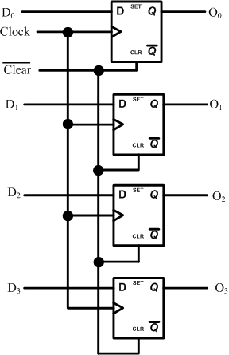
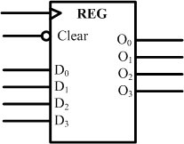
A Basic Register
Data input, clock input, and clear
Register output is O
This is a common form of data register with clear.
9/15/09 - L25 Registers & Load Enable
Copyright 2009 - Joanne DeGroat, ECE, OSU

Slide 6
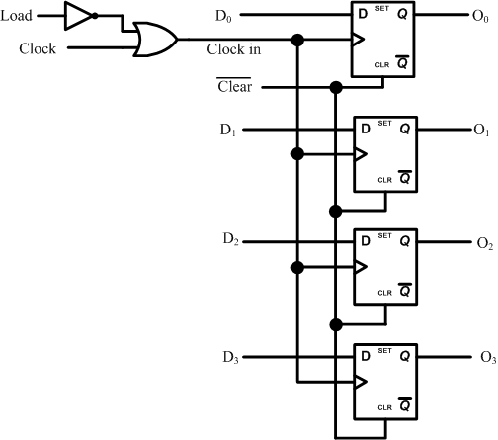
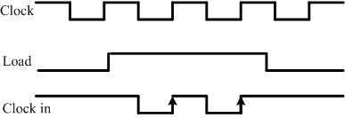
Clocked inputs
Load only when the Load is asserted
Using the clocked inputs
9/15/09 - L25 Registers & Load Enable
Copyright 2009 - Joanne DeGroat, ECE, OSU

Slide 7
Another approach to load control
The method used in most computers
The register ‘Load’ signal is generated much like the circuit of the previous slide.
Provides more control over timing within the architecture.
9/15/09 - L25 Registers & Load Enable
Copyright 2009 - Joanne DeGroat, ECE, OSU

Slide 8
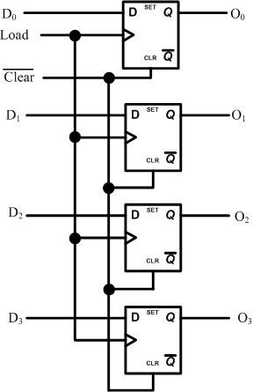
Register with “Load”
Here the load signal is generated by the control unit at the correct timing point.
9/15/09 - L25 Registers & Load Enable
Copyright 2009 - Joanne DeGroat, ECE, OSU

Slide 9
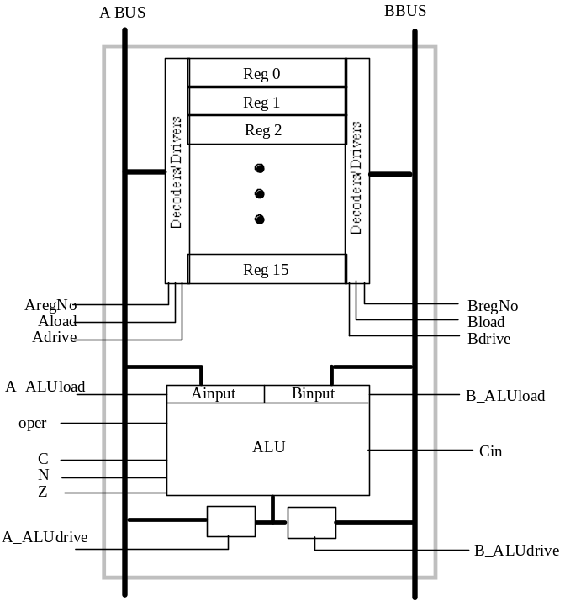
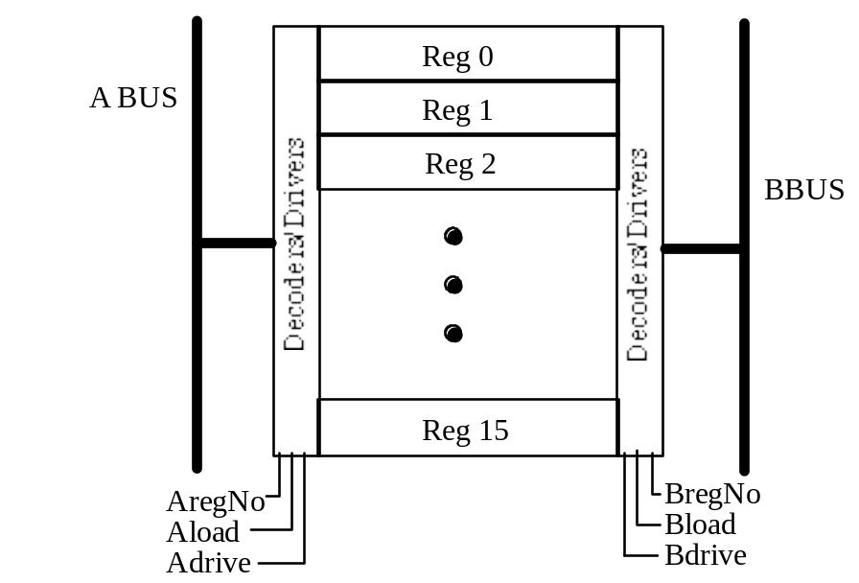
Registers and the datapath
Show diagram of datapath with dual ported registers.
9/15/09 - L25 Registers & Load Enable
Copyright 2009 - Joanne DeGroat, ECE, OSU

Slide 10
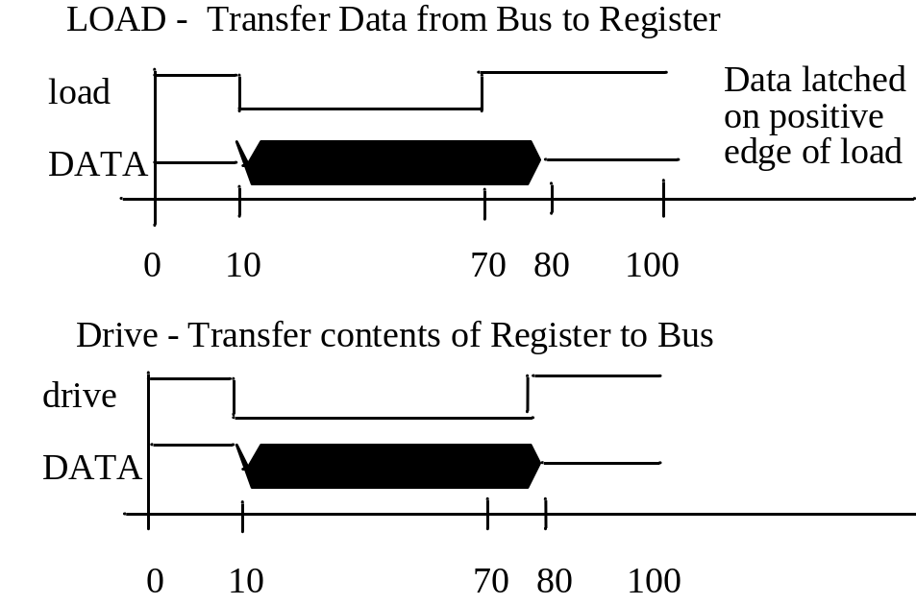
Register Timing
Load signal is generated to occur at specific points in the bus cycle period
9/15/09 - L25 Registers & Load Enable
Copyright 2009 - Joanne DeGroat, ECE, OSU

Slide 11
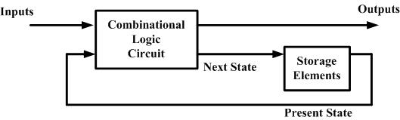
Data registers and state machines
The state of a state machine is kept in a loadable register. This is shown on the diagram as the ‘storage elements.’
9/15/09 - L25 Registers & Load Enable
Copyright 2009 - Joanne DeGroat, ECE, OSU

Slide 12
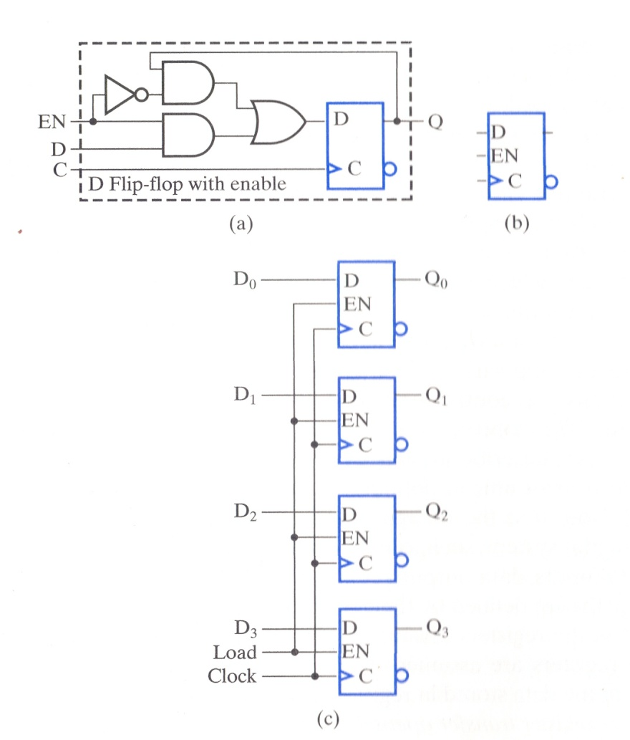
D FF with enable
Enable, EN, routes either the current value of or a new input to the D input of the internal D FF.
At the logical block level you see D, EN, and the Clk as inputs.
9/15/09 - L25 Registers & Load Enable
Copyright 2009 - Joanne DeGroat, ECE, OSU

Slide 13
Class 25 assignment
Covered sections 5-6
Problems for hand in
  Nothing new
Problems for practice
  Nothing new
Reading for next class: 7-6
9/15/09 - L25 Registers & Load Enable
Copyright 2009 - Joanne DeGroat, ECE, OSU

